Slide 1
Computer Organization and Architecture
23CSE213

Slide 2

Overview and history of computer architecture

Slide 3
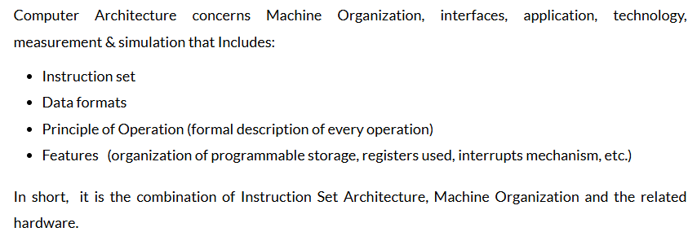

Slide 4
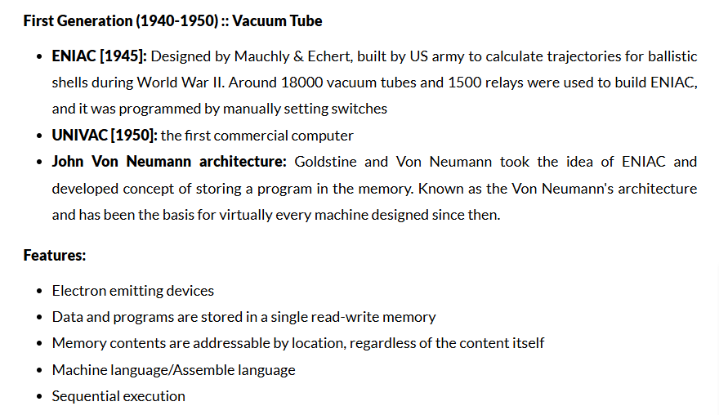
Evolution of Computers

Slide 5
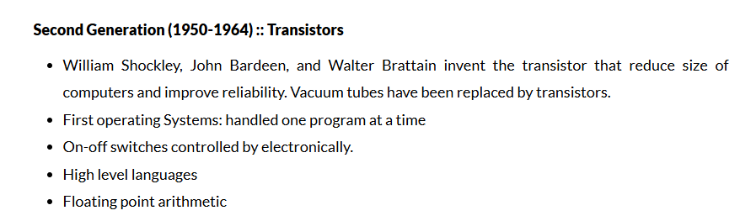

Slide 6
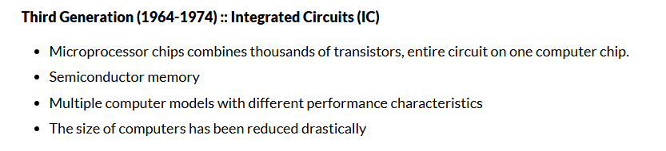

Slide 7
Fourth Generation computers(1971-1980)
Computers of fourth generation used Very Large Scale Integrated (VLSI) circuits.
VLSI circuits having about 5000 transistors and other circuit elements with their associated circuits on a single chip made it possible to have microcomputers of fourth generation.
Fourth generation computers became more powerful, compact, reliable, and affordable.
As a result, it gave rise to Personal Computer (PC) revolution. In this generation, time sharing, real time networks, distributed operating system were used.
All the high-level languages like C, C++, DBASE etc., were used in this generation.

Slide 8
Fifth generation is 1980-till date
In the fifth generation, VLSI technology became ULSI (Ultra Large Scale Integration) technology, resulting in the production of microprocessor chips having ten million electronic components.
This generation is based on parallel processing hardware and AI (Artificial Intelligence) software.
AI is an emerging branch in computer science, which interprets the means and method of making computers think like human beings.
All the high-level languages like C and C++, Java, .Net etc., are used in this generation.

Slide 9
Components of Computer Architecture
The main components of a computer architecture are the CPU, memory, and peripherals.
All these elements are linked by the system bus, which comprises an address bus, a data bus, and a control bus.
Within this framework, the computer architecture has eight key components, as described below.

Slide 10
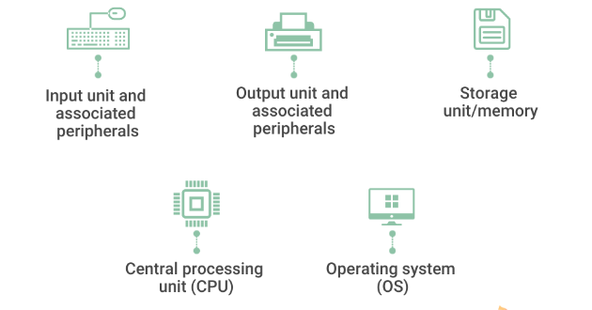

Slide 11
1. Input unit and associated peripherals
The input unit provides external data sources to the computer system. Therefore, it connects the external environment to the computer.
It receives information from input devices, translates it to machine language, and then inserts it within the computer system.
The keyboard, mouse, or other input devices are the most often utilized and have corresponding hardware drivers that allow them to work in sync with the rest of the computer architecture.

Slide 12
2. Output unit and associated peripherals
The output unit delivers the computer process’s results to the user.
A majority of the output data comprises music, graphics, or video.
A computer architecture’s output devices encompass the display, printing unit, speakers, headphones, etc.
Eg: To play an MP3 file, for instance, the system reads a number array from the disc and into memory. The computer architecture manipulates these numbers to convert compressed audio data to uncompressed audio data and then outputs the resulting set of numbers (uncompressed audio file) to the audio chips. The chip then makes it user-ready through the output unit and associated peripherals.

Slide 13
3. Storage unit/memory
The storage unit contains numerous computer parts that are employed to store data. It is typically separated into primary storage and secondary storage.
Primary storage unit
This component of the computer architecture is also referred to as the main memory, as the CPU has direct access to it.
Primary memory is utilized for storing information and instructions during program execution.
Random access memory (RAM) and read-only memory (ROM) are the two kinds of memory:

Slide 14
RAM supplies the necessary information straight to the CPU.
It is a temporary memory that stores data and instructions intermittently.
ROM is a memory type that contains pre-installed instructions, including firmware.
This memory’s content is persistent and cannot be modified. ROM is utilized to boot the machine upon initial startup.
The computer is now unaware of anything outside the ROM.
The chip instructs it on how to set up the computer architecture, conduct a power-on self-test (POST), and finally locate the hard drive so that the operating system can be launched.

Slide 15
Secondary storage unit
Secondary or external storage is inaccessible directly to the CPU. Before the CPU uses secondary storage data, it must be transferred to the main storage.
Secondary storage permanently retains vast amounts of data. Examples include hard disk drives (HDDs), solid-state drives (SSDs), compact disks (CDs), etc

Slide 16
4. Central processing unit (CPU)
The central processing unit includes registers, an arithmetic logic unit (ALU), and control circuits, which interpret and execute assembly language instructions.
The CPU interacts with all the other parts of the computer architecture to make sense of the data and deliver the necessary output.

Slide 17
1. Registers
These are high-speed and purpose-built temporary memory devices. Rather than being referred to by their address, they are accessed and modified directly by the CPU throughout execution.
Essentially, they contain data that the CPU is presently processing. Registers contain information, commands, addresses, and intermediate processing results.

Slide 18
2. Arithmetic logic unit (ALU)
The arithmetic logic unit includes the electrical circuitry that performs any arithmetic and logical processes on the supplied data.
It is used to execute all arithmetic (additions, subtractions, multiplication, division) and logical (<, >, AND, OR, etc.) computations. Registers are used by the ALU to retain the data being processed.

Slide 19
3. Control unit
The control unit collaborates with the computer’s input and output devices.
It instructs the computer to execute stored program instructions via communication with the ALU and registers.
The control unit aims to arrange data and instruction processing.

Slide 20
4. Buses
A bus is a tangible collection of signal lines with a linked purpose; a good example is the universal serial bus (USB).
Buses enable the flow of electrical impulses between various components of a computer’s design, transferring information from one system to another.
The size of a bus is the count of information-transferring signal lines.
A bus with a size of 8 bits, for instance, transports 8 data bits in a parallel formation.

Slide 21








Eight Great Ideas
Design for Moore’s Law
Use abstraction to simplify design
Make the common case fast
Performance via parallelism
Performance via pipelining
Performance via prediction
Hierarchy of memories
Dependability via redundancy

Slide 22
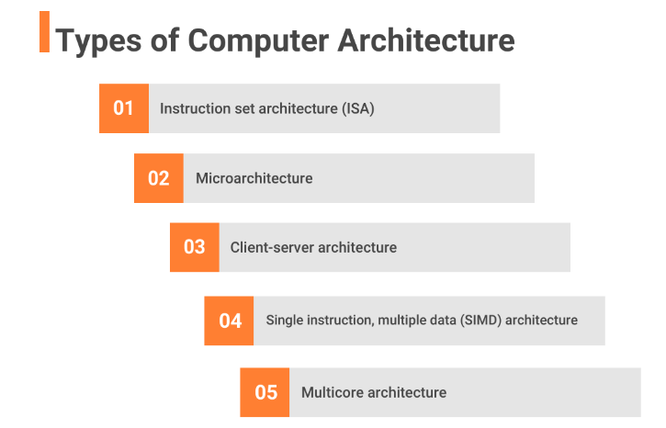

Slide 23
1. Instruction set architecture (ISA)
Instruction set architecture (ISA) is a bridge between the software and hardware of a computer. It functions as a programmer’s viewpoint on a machine.
Computers can only comprehend binary language (0 and 1), but humans can comprehend high-level language (if-else, while, conditions, and the like).
Consequently, ISA plays a crucial role in user-computer communications by translating high-level language into binary language.

Slide 24
Arithmetic/logic instructions: These instructions execute various mathematical or logical processing elements solely on a single or maybe more operands (data inputs).
Data transfer instructions: These instructions move commands from the memory or into the processor registers, or vice versa.
Branch and jump instructions: These instructions are essential to interrupt the logical sequence of instructions and jump to other destinations.

Slide 25
2. Microarchitecture
Microarchitecture, unlike ISA, focuses on the implementation of how instructions will be executed at a lower level. This is influenced by the microprocessor’s structural design.

Slide 26
3. Client-server architecture
Multiple clients (remote processors) may request and get services from a single, centralized server in a client-server system (host computer).
Client computers allow users to request services from the server and receive the server’s reply. Servers receive and react to client inquiries.
A server should provide clients with a standardized, transparent interface so that they are unaware of the system’s features (software and hardware components) that are used to provide the service.
Clients are often located on desktops or laptops, while servers are typically located somewhere else on the network, on more powerful hardware.
This computer architecture is most efficient when the clients and the servers frequently perform pre-specified responsibilities.

Slide 27
4. Single instruction, multiple data (SIMD) architecture
Single instruction, multiple data (SIMD) computer systems can process multiple data points concurrently.
This cleared the path for supercomputers and other devices with incredible performance capabilities.
In this form of design, all processors receive an identical command from the control unit yet operate on distinct data packets.
The shared memory unit requires numerous modules to interact with all CPUs concurrently

Slide 28
.5.Multicore architecture
Multicore is a framework wherein a single physical processor has the logic of multiple processors.
A multicore architecture integrates numerous processing cores onto only one integrated circuit.
The goal is to develop a system capable of doing more tasks concurrently, improving overall system performance.

Slide 29
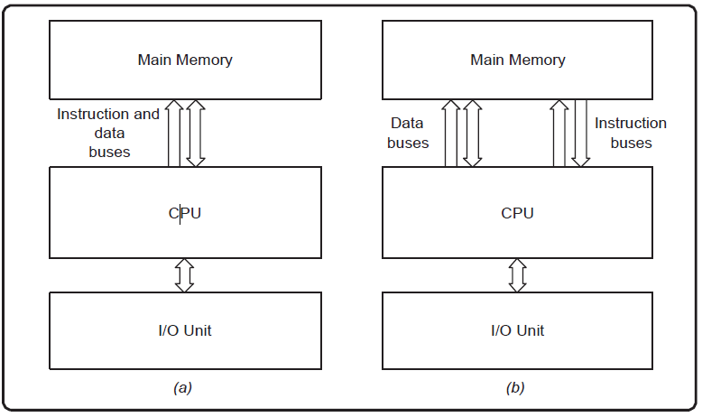
Examples of Computer Architecture

Slide 30
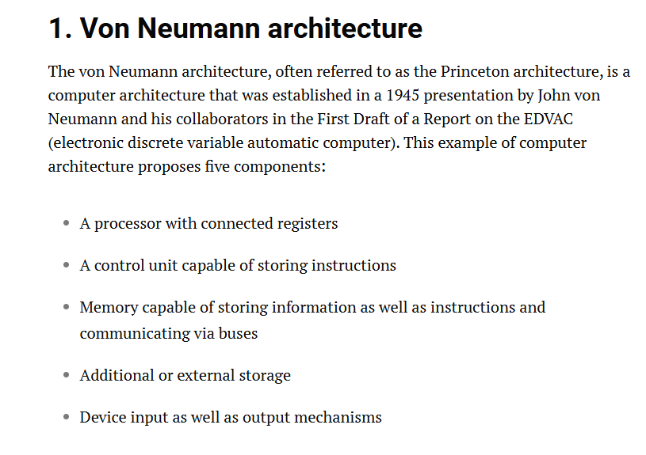

Slide 31
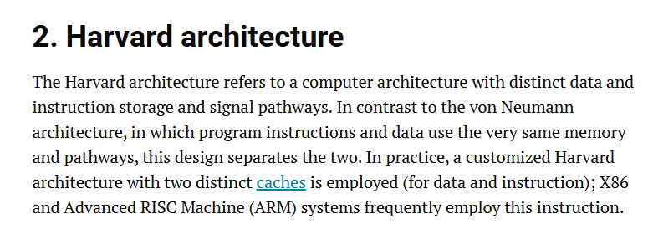

Slide 32
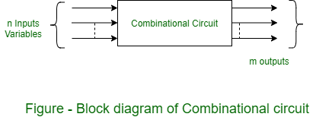
Combinational and Sequential logic
What is Combinational Circuit?
A combinational circuit is a kind of digital electronic circuit of which outputs depend on the present inputs and have no connections to the past inputs.
These circuits do such tasks as additions, subtractions and logically AND, OR and NOR circuits.

Slide 33
The key characteristics of combinational circuits include:
No Memory Elements: The output is dependent solely on the current policy inputs.
Immediate Response: Good input differs from its output and bad input differs from its output.
Examples: The most commonly encountered examples are adders, multiplexers and encoders.

Slide 34
Advantages of Combinational Circuits
Simplicity: It is easier to design and implement more so because it lacks memory elements mainly.
Speed: Operational at a faster rate as the output automatically adjusts with the changes in inputs.
Resource Efficiency: Generally it needs far fewer components as compared to its equivalent sequential circuits.

Slide 35
Disadvantages of Combinational Circuits
Limited Functionality: Is not able to perform operations that need historical information or sequence details.
Complexity with Increased Inputs: It becomes difficult to design combinational circuits when there are many inputs.

Slide 36
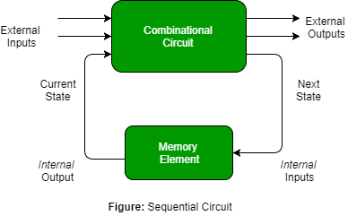
What is Sequential Circuit?
Sequential circuits are quite different from combinational circuits in the sense that they employ memory components.
A sequential circuit provides output based on current inputs as well as prior inputs; therefore, it is more functional.

Slide 37
Advantages of Sequential Circuits
Memory Utilization: Able to store the previous states in order to perform the operations.
Functional Versatility: It is used for those tasks which need a series of operations, state machines, and counters.

Slide 38
Disadvantages of Sequential Circuits
Complexity: More difficult to design compared to counter-propagators due to the use of memory elements.
Slower Operation: Output changes may represent a delay because often they require data processing from the past.

Slide 39
Aspect | Combinational Circuit | Sequential Circuit
Definition | Output depends only on the current inputs. | Output depends on both current inputs and past states (memory).
Memory Elements | Does not require memory elements. | Requires memory elements like flip-flops or latches.
Timing Dependency | Output is immediate, based on input changes. | Output is dependent on clock pulses and previous states.
Clock Signal | No clock signal required. | Requires a clock signal to synchronize state changes.
Design Complexity | Simpler design without the need for memory. | More complex due to memory and clock management.
Speed | Faster, as outputs change instantly with inputs. | Slower due to dependency on clock cycles and past states.
Functionality | Performs basic logical operations without sequence dependency. | Performs operations that require sequences or timed events.
Examples | Adders, Subtractors, Multiplexers, Encoders. | Counters, Shift Registers, Flip-Flops, State Machines.
Power Consumption | Generally lower power consumption. | Higher power consumption due to memory and clock circuitry.
Application | Used in tasks requiring direct logical operations (e.g., arithmetic). | Used in applications involving sequential operations (e.g., counters, registers).

Slide 40
VHDL - Very High Speed Integrated Circuit Hardware Description Language
VHDL is one of the type of hardware description language which describes the behavior of an integrated circuit or system which is used to implement physical circuit or system.
VHDL is an abbreviation for VHSIC which stands for Very High Speed Integrated Circuit Hardware Description Language.

Slide 41
What Are Hardware Description Languages (HDLs)?
Hardware Description Languages(HDL) are special programming languages used to describe the structure and behavior of electronic circuits.
Hardware Description Languages are required for designing various electronic components such as processors, motherboards and Field Programmable Gate Arrays.
The difference between the traditional programming languages and the Hardware Description Languages is that Hardware Description Languages operate with respect to clock signals and delays.
In Hardware Description Languages time is an important parameter.

Slide 42
What is VHDL ?
VHDL is one of the type of hardware description language which describes the behavior of an integrated circuit or system which is used to implement physical circuit or system.
VHDL is an abbreviation for VHSIC which stands for Very High Speed Integrated Circuit Hardware Description Language.
VHDL is a standard ,portable, reusable and vendor independent language.
VHDL program code can be used to implement the circuit in programmable device like Complex Programmable Logic Device (CPLD) , Field Programmable Gate Array (FPGA) or used for fabrication of an ASIC chips.
It is a hardware description language that can be used to model a digital system at many levels of abstraction.

Slide 43
What is Verilog ?
Verilog is a hardware description language (HDL) that is used to describe digital systems and circuits in the form of code.
It was developed by Gateway Design Automation in the mid-1980s and later acquired by Cadence Design Systems.
Verilog is widely used for design and verification of digital and mixed-signal systems, including both application-specific integrated circuits (ASICs) and field-programmable gate arrays (FPGAs). It supports a range of levels of abstraction, from structural to behavioral, and is used for both simulation-based design and synthesis-based design.

Slide 44
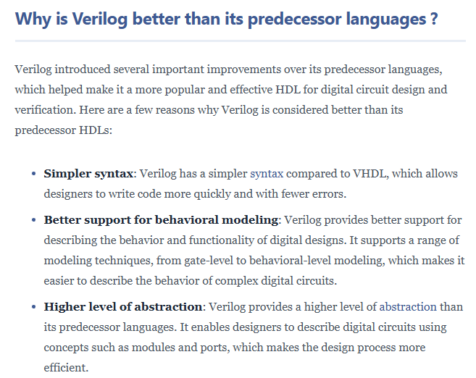

Slide 45
Verilog Modeling Styles
Data Flow modeling:
A data flow model specifies, how data is been processed through the circuit using concurrent signal assignment statements and block statements.
There is no specified ordering of these statements therefore the ordering of these statements in an architecture body is not important.
It requires Boolean equations for designing circuit specifications.

Slide 46
Boolean equations are series of equations defining signal relationship.
Data flow modeling focuses mainly on the how data flows through the system instead of focusing on components.
Data flow Modeling is suitable for simple logic which allows us to express data flow efficiently.
However it can be complicated for intricate designs with complex control flow.

Slide 47
Behavioral modeling:
Behavioral modeling follows a more procedural approach, similar to writing a program.
In Behavioral modeling processes with control flow statements like if-then-else define how the design should react to input and update its output.
The set of instructions written by the programmer decide the system's behavior under different conditions.

Slide 48
Behavioral modeling has great flexibility for modeling complex logic with control flow.
Hence it is suitable for describing intricate algorithms within the hardware.
Behavioral modeling is great for describing how things work, but it is difficult to see exactly how the hardware is built compared to structural modeling.

Slide 49
Structural Modeling: In Structural modeling the user don't need to design the internal working of each component.
We can simply use them in the design by giving them unique names. Hence it provides a clear, circuit-like view where each block is a known as entity.
Since structural modeling uses pre-verified components, troubleshooting becomes easier. Focusing on connections is more important rather than internal behavior.

Slide 50
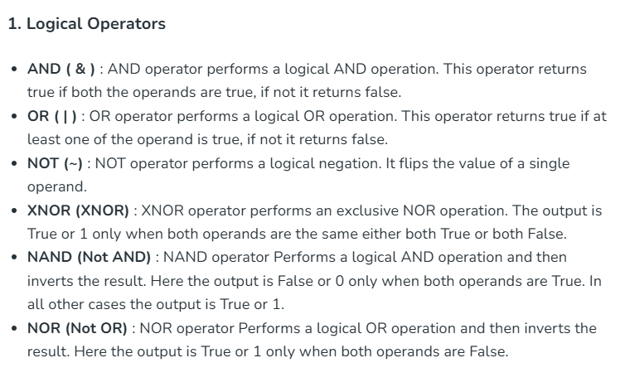
VHDL Operators

Slide 51
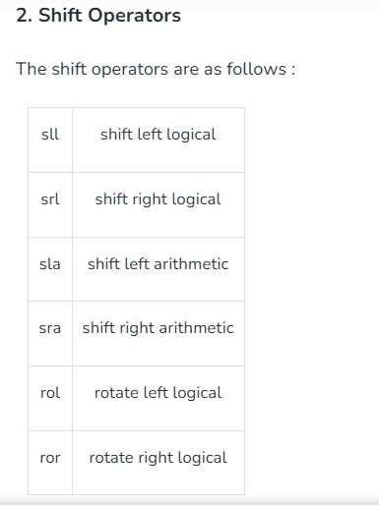

Slide 52
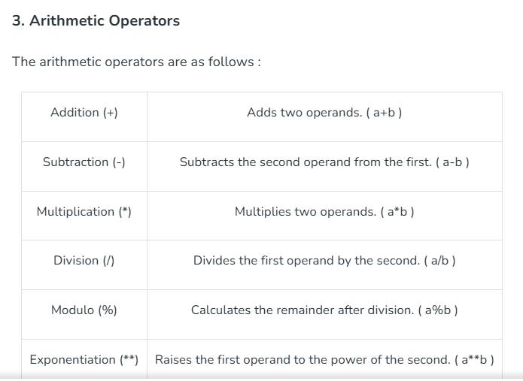

Slide 53
Advantages of VHDL
VHDL is a standard language and has simpler syntax like Ada language.
It describes the behavior of digital circuits and systems using testbench.
It is a strongly typed language. It supports a multi-level abstraction.
Signed and unsigned numbers can be used in VHDL.
VHDL language supports readily available tools, supports all CAD tools.

Slide 54
Disadvantages of VHDL
It has more wordy and complicated coding.
Every bit vector use the keyword "down to" is very tedious.
Sometimes very long sensitivity list must have in each process.
Missing a single signal in sensitivity list may fail simulation and synthesis.
Synthesized hardware from a VHDL description may not always be immediately obvious.

Slide 55
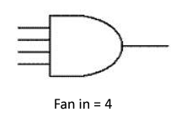
Physical Constraints
Physical constraints in digital systems include gate delay, fan-in, fan-out, and power:
Gate delay: The time it takes for a gate to propagate an input signal to the output. It's measured in nanoseconds.
Fan-in: The maximum number of inputs that can be connected to a logic gate.

Slide 56
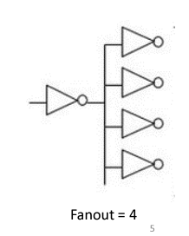
Fan-out: The maximum number of units that can be connected to the output of a logic gate.

Slide 57
Instruction set architecture (ISA)
Instruction set architecture (ISA) is the code that a computer's processor (CPU) can understand.
It's written in machine language, which is made up of 1s and 0s.
The instructions in ISA control how bits and bytes move within the processor.

Slide 58
The ISA acts as an interface between the hardware and the software, specifying both what the processor is capable of doing as well as how it gets done.
The ISA provides the only way through which a user is able to interact with the hardware. It can be viewed as a programmer’s manual because it’s the portion of the machine that’s visible to the assembly language programmer, the compiler writer, and the application programmer.
The ISA defines the supported data types, the registers, how the hardware manages main memory, key features (such as virtual memory), which instructions a microprocessor can execute, and the input/output model of multiple ISA implementations. The ISA can be extended by adding instructions or other capabilities, or by adding support for larger addresses and data values.

Slide 59
Eg of ISA
ARM: An Advanced RISC Machine processor that is commonly used in mobile devices, such as Apple's iPhones, iPods, and iPads, and most Android phones
MIPS: A Microprocessor without Interlocked Pipeline Stages processor that is often used in embedded systems like video game consoles
IA-32: The dominant ISA design on desktops and laptops
PowerPC: Used on the Nintendo Wii, the Gamecube, and network devices such as switches and routers
Freescale's Power Architecture: Used in the Xbox 360 and Playstation 3
Atmel AVR: Used in embedded environments such as motor cars

Slide 60
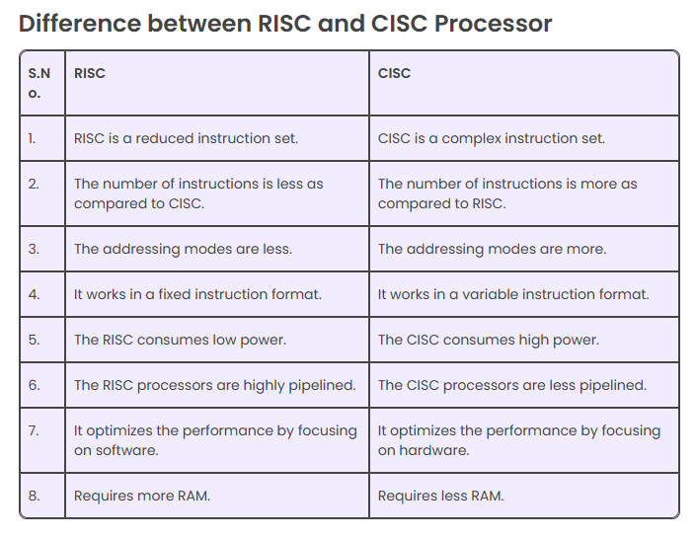

Slide 61
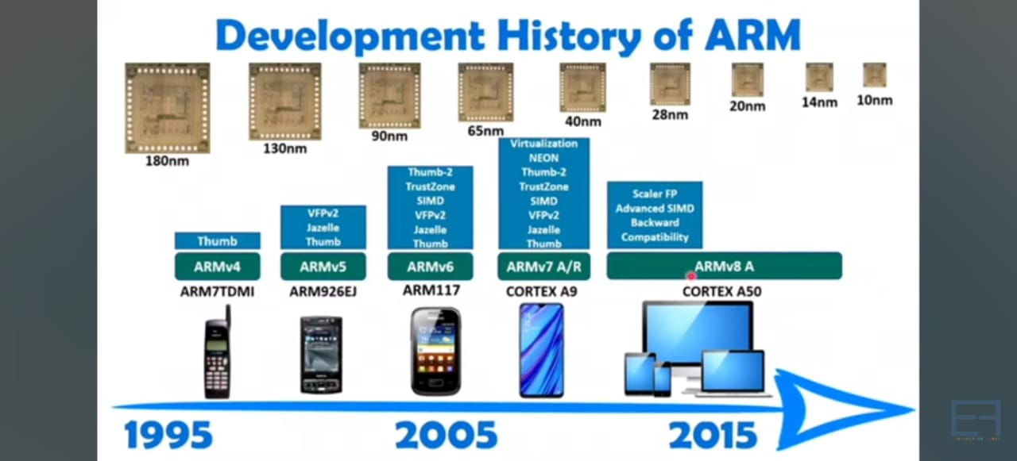
Evolution of ARM

Slide 62
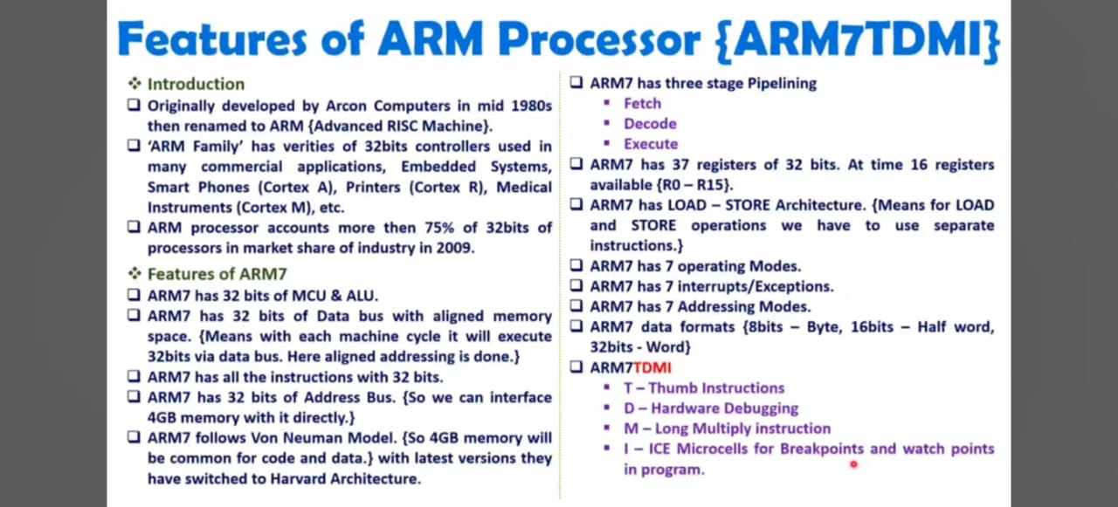
FEATURES OF ARM

Slide 63
ARM Processor
ARM is apopular low power embedded processor.Itscore is based on the RISC architecture.
In 1985 the first prototype was introduced under the name Acorn RISC machine later renamed as Advanced RISC Machine (ARM).
Being a RISC machine the design is simple which means it can be built by less number of transistors.
It’s easy to program high density code and low power consumption makes it suitable for embedded applications.

Slide 64
ARM is based on the load store architecture.
This means the access of memory is done via these two instructions.
The load instruction copies data from memory to the register file, whereas the store instruction writes the data from the registers to the memory.
All the arithmetic and logical instructions access only the register file, thus keeping the operand access less time consuming and simple.
Basically the core is a 32 bit processor, extended to 64 bit from the revision ARM9 family onwards.

Slide 65
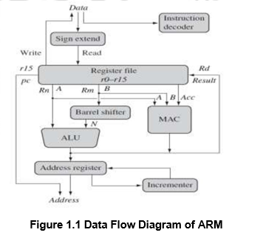
Functional Blocks of ARM

Slide 66
The functional units are connected by data bus.
The Arithmetic Logic Unit (ALU) and Multiply-Accumulate unit (MAC) retrieve value from data path A and B and store the answer back in the register file.
One of the integral parts of the core is the Barrel Shifter (BS).
It is used in pre-processing the source operand Rm.
The BS along with ALU is used in calculating many different expressions.
The base address is generated by the ALU for the load and store instructions and stored in the address register.
The core is capable of accessing an array of memory locations with help of the incrementer.
It auto-increments, to access the next sequential memory location until an exception or interrupt changes the flow of execution.

Slide 67
Design of ALU in ARM
The role of the ALU is to decode the operational activities of the arithmetic and logic in electronic code and then perform the corresponding function on the bus information and the existing data in the accumulator.
If the legitimate arithmetic logic unit is small, the Bus significance for all bits should be established to Z.
The Arithmetic and Logic Unit seems to have the same clock and reconfigure transmissions as the PC, as well as the same bus interface characterized as just an input and output form logic module bus.

Slide 68
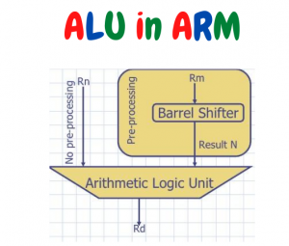
Indeed, the arithmetic logic unit does have three additional control signals that can be decrypted to track to the ALU’s 8 specific components.
The ALU also includes the Accumulator that is an input of the height adjustment for the length of the system bus.
There seems to be a single bit outcome arithmetic unit zero that also goes high once all the bits are zero in the accumulator.

Slide 69
Booth Multiplier Factor:
The multiplier element has 3 32-bit inputs, as well as the register file returns the inputs.
The performance of the generator is scarcely 32-Least Significant Commodity Bits.
The multiplier variable description of the entity is seen in the block diagram described.
The multiplication begins every time the 04 input begins to go work. Finishing the production goes up high at the edge.

Slide 70
Booth Algorithm:
The booth algorithm is a notable algorithmic principle of multiplication for the supplement number of 2.
This equally views all positive and negative numbers.
In insertion, the 0’s or 1’s runs within the multiplier element are passed over with no addition or subtraction becoming done, thus creating the possibility of faster multiplication.
It is obvious that perhaps the multiplication ends just in the span of the 16 clocks.

Slide 71
Barrel Shifter:
A barrel shifter is a logic circuit that allows you to change a term by a different number.
It does have a control input determining how many bits positions it moves by.
A barrel shifter is enacted with a pattern of shift multiplexers, the 16-bit thumb steps involve only different directions to obtain the barrel shifter.
32 bit Thumb directions offer the barrel shifter nearly the very same direct exposure as the ARM commands.
The center of the ARM includes a barrel shifter that takes a value to shift or rotation, a quantity to shift or adjust by, and the form of shift or rotation.
This can be used to conduct relatively complicated operating systems on a single instruction by different classes of ARM guidelines.

Slide 72
Control Unit:
The control unit is the main element of a central processing unit (CPU) in computing which can coordinate the activities by the CPU / computer during the execution of the program.
The control unit’s principal purpose is to receive and receive commands from a computer’s memory.
The Control system is the portion of the central processing unit (CPU) of a computer that guides process or procedure.

Slide 73
John von Neumann had included it as part of the Von Neumann architecture design.
The Control Unit is responsible for telling the computer’s memory, arithmetic/logic module, and input and operations that can be applied to commands sent to the CPU.
It collects the services’ internal directions from the main memory to the CPU instruction register, and the control unit creates a reference voltage that inspects the implementation of those instructions based on just this register material.

Slide 74
Data Size and Instruction Set
The data processing capability of the instruction basically depends on the register width.
The group of registers called the register file typically holds a signed or unsigned 32/64 bit data depending on the ARM core family.
The ARM sign extend hardware converts the Byte (8 bits) and Halfword (16 bits or two bytes) into Word (32 bits or four bytes) to store in the register file.

Slide 75
ARM implements three categories of instruction sets:
32-bit ARM Instruction Set,
16-bit Thumb Instruction Set,
8-bit Jazelle instruction set – Jazelle cores can also execute Java bytecode.
The “current program status register” decides which instruction set will be executed.
The instruction set typically uses a three address format with one destination operand Rd and two source operands Rn and Rm.

Slide 76
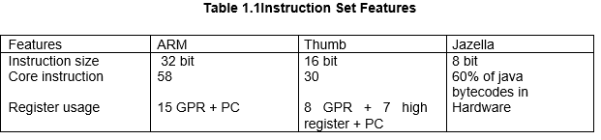

Slide 77
Register Modes
The ARM has seven basic operating modes: six privileged mode and one non privileged mode (user). The privileged modes are used to service interrupt , exception and access protected resources.
User Mode : is an unprivileged mode under which most tasks run. This mode is used for executing application programs.

Slide 78
System mode : is a privileged mode to run user and system programs. Under this mode the user has all the access permissions. This mode uses the same set of registers as the non privileged user mode.
Supervisor Mode: This is the mode where in the OS kernel operates. This mode is entered on reset and when a Software Interrupt instruction is executed.

Slide 79
Two of the privilege modes are allocated for interrupt handling. In general, ARM has two levels of interrupts.
Fast Interrupt Request (FIQ) : FIQ mode is entered when a high priority (fast) interrupt is raised. FIQ supports channel communication for data transfer.
Interrupt Request (IRQ) :IRQ is entered when a low priority (normal) interrupt is raised. This is a privileged mode for general purpose interrupt handling.

Slide 80
Abort : used to handle memory access violations. The abort mode handles data abort.
Undefined : used to handle undefined instructions that are not supported by the implementation.

Slide 81
ARM REgisters
The ARM architecture provides sixteen 32-bit general purpose registers (R0-R15) for software use.
Fifteen of them (R0-R14) can be used for general purpose data storage, while R15 is the program counter whose value is altered as the core executes instructions.
An explicit write to R15 by software will alter program flow.
Software can also access the CPSR, and a saved copy of the CPSR from the previously executed mode, called the Saved Program Status Register (SPSR)

Slide 82
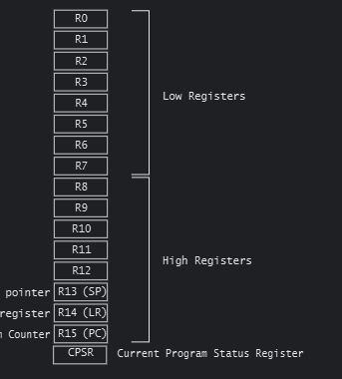
ARM Registers
Although software can access the registers, depending on which mode the software is executing in and the register being accessed, a register might correspond to a different physical storage location.
This is called banking, the shaded registers in Figure are banked. They use physically distinct storage and are usually accessible only when a process is executing in that particular mode.

Slide 83
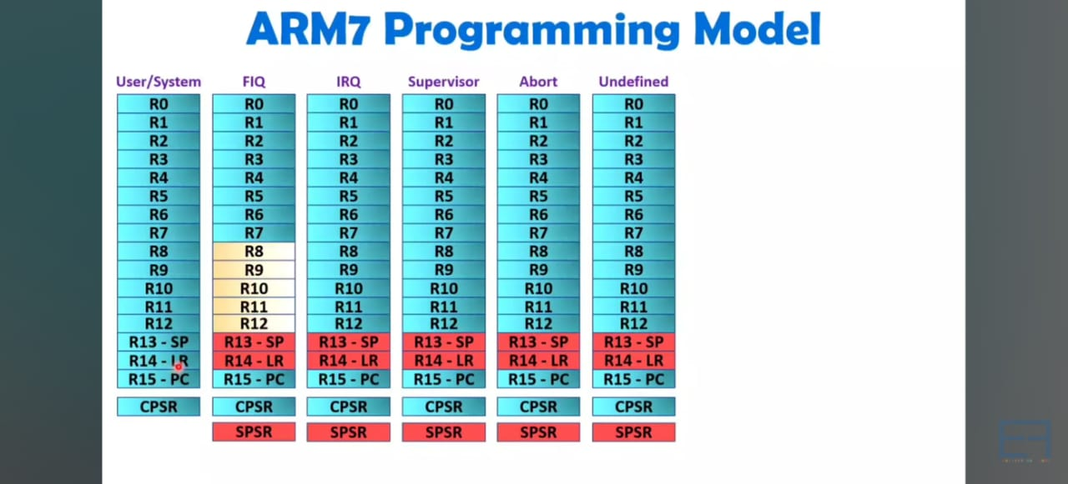
ARM Register Set

Slide 84
The registers are broadly classified into Special Purpose Registers(SPR) and General Purpose Registers(GPR).
The SPRs are processor driven registers and GPRs are for the programmer.
Overall there are about 18 active registers of which 16 registers r0 to r15 are visible to the user.
In this the registers r13, r14 and r15 are used as the stack pointer, link register(lr) and program counter(pc) respectively.

Slide 85
The lr is used to store the return address whenever the control shifts to the subroutine.
There are two program status registers CPSR and SPSR (current program status register and saved program status register).
Out of the 37 registers, 20 registers are used orthogonally under different banks. The processor mode decides which bank is accessible.

Slide 86
ARM Register Set
The shaded region in Figure shows the way the registers are used for different privileged and non privileged modes.
On the left is the user and system mode and on the right side the currently visible set of registers is shown for each privileged mode.
All instructions can access GPRs and only a few instructions can access the SPRs.
One of the prominent SPR is Program Status Register (PSR).
The PSR in ARM represents the outcome of internal operations.
It helps in monitoring the status of the processor.

Slide 87
The PSR is generally referred to as Current PSR.
There is another PSR for storage purpose called Saved PSR (SPSR).
The processor switches from one mode to another on demand of a interrupt, exception and privileged instruction.
As the processor transits via a privileged mode to non privileged mode vice versa,the current executing mode CPSR is saved in the SPSR of the initiator mode.
After completion of the task, it moves back to the earlier switched mode.
This procedure is similar to context switching.
At the end a special return instruction it copies the SPSR into the CPSR.

Slide 88
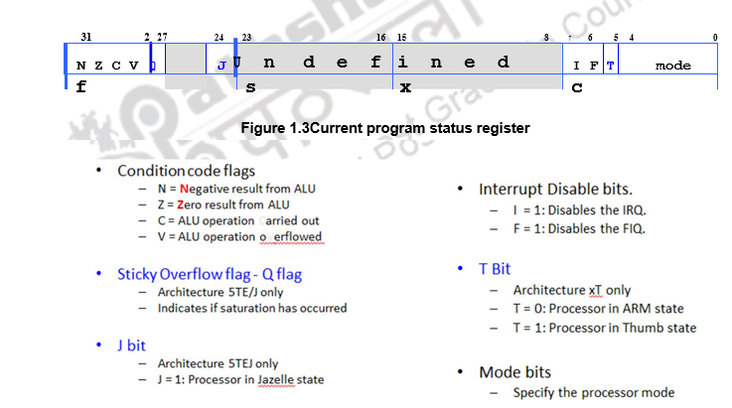

Slide 89
The Condition Code(CC)bits Negative(N), Zero(Z), Carry(C) and overflow(V) are set on the occurrence of respective result.
All Thumb instructions and few ARM instruction affect the CC flags.
The ARM instruction can influence the cc,if they are appended with a S variable in the instruction.
Sticky overflow flag (Q flag) is set either when saturation occurs during signed add and subtract and Double add and subtract (QADD, QDADD, QSUB or QDSUB), or the result of signed multiply and accumulate multiple and accumulate word (SML Axy or SML AWx) overflows 32-bits.

Slide 90
Bits that are reserved for future use should not be modified by current software.
Typically, a read-modify-write strategy should be used to update the value of a status register to ensure future compatibility.
Note that the T/J bits in the CPSR should never be changed directly by writing to the PSR.
This is used by Branch exchange or branch link exchange (BX/BLX) instruction to change the state.
The processor is in ARM stateon reset, following an interrupt, or during exception execution.
The mode of the processor can be changed by using data transfer instruction and writing into the specific mode bit.

Slide 91
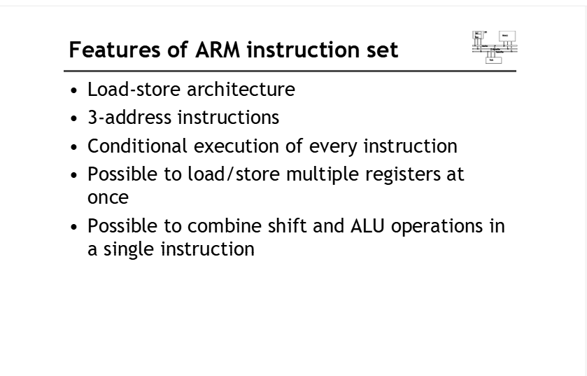
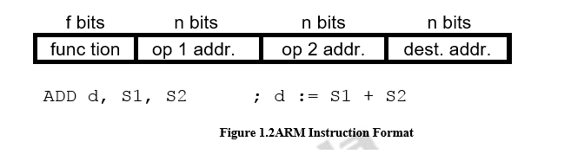
ARM Instruction Set

Slide 92
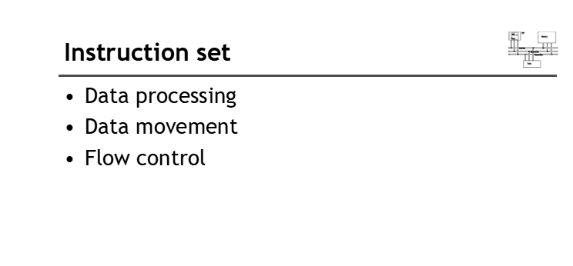

Slide 93
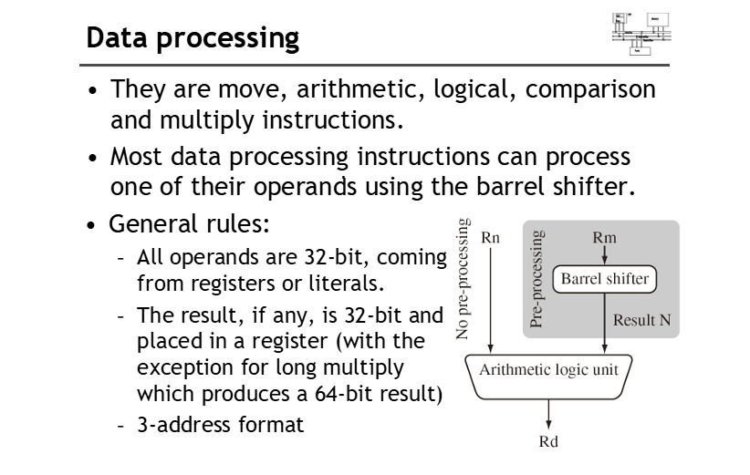

Slide 94
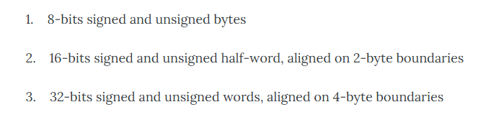
ARM Datatypes
Notes:
To be done

Slide 95
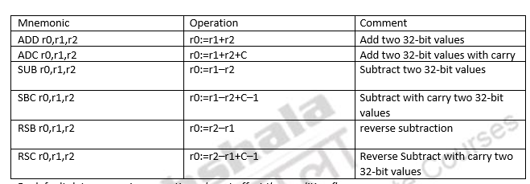
Arithmetic Instructions
Notes:
RSC => r0 = r2 – r2 – (1-c)

Slide 96
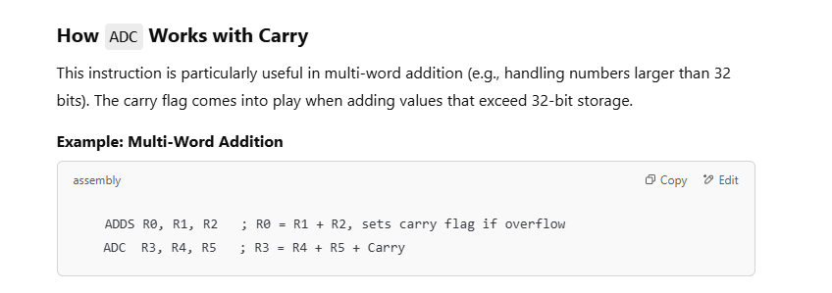
Notes:
First add -> set carry flag -> then add the carry value

Slide 97
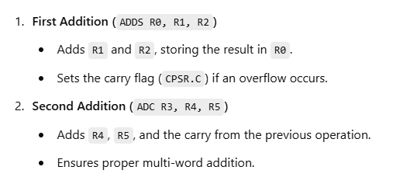

Slide 98
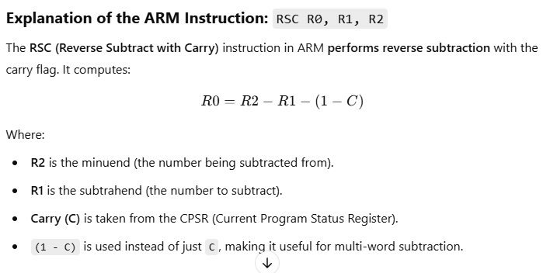

Slide 99
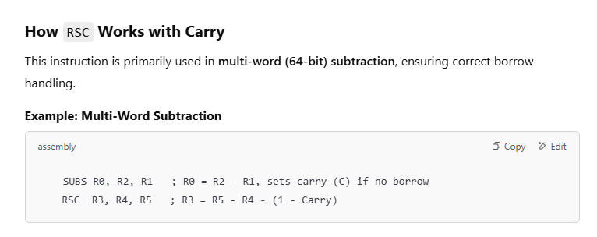

Slide 100
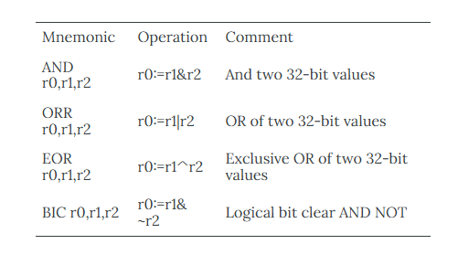
Logical instructions MVN –Bitwise NOT (MVN R1,R2)

Slide 101
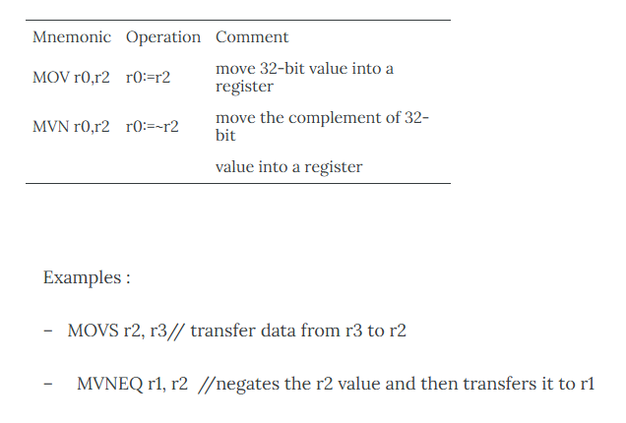
Register Move instruction

Slide 102
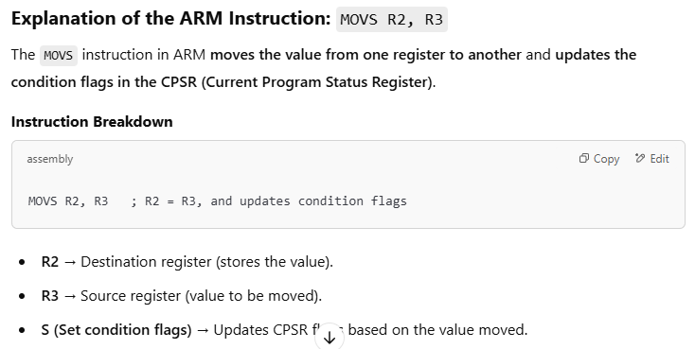

Slide 103
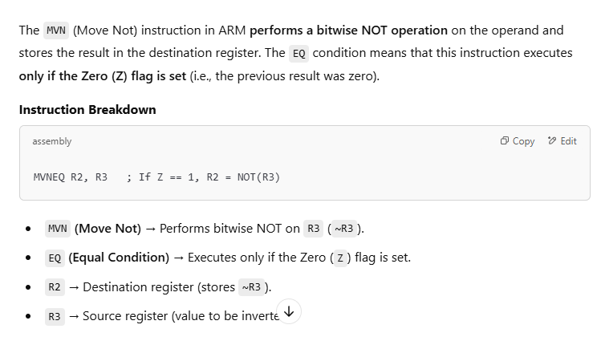

Slide 104
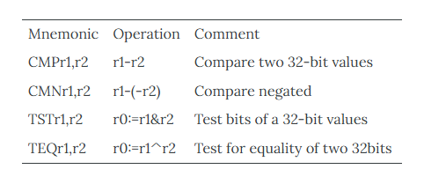
Compare instructions

Slide 105
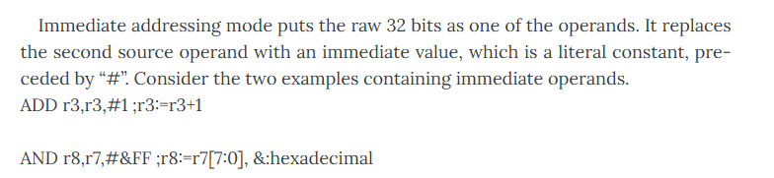
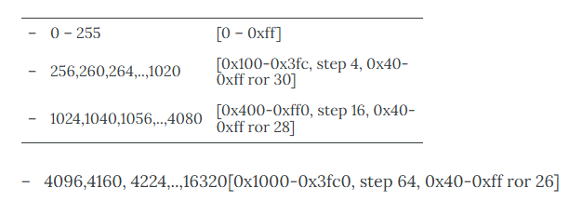
Immediate operands

Slide 106
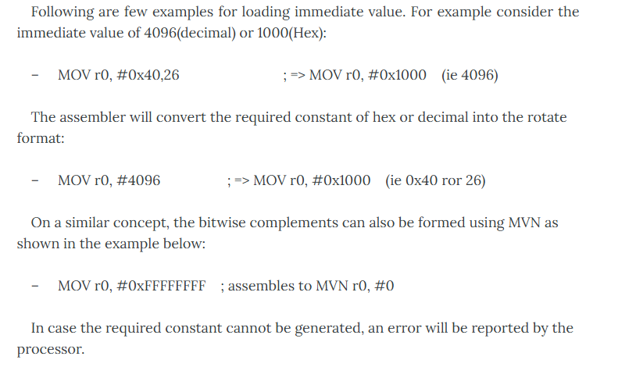

Slide 107
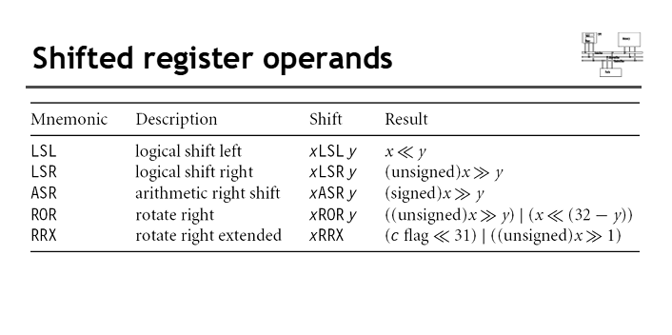

Slide 108
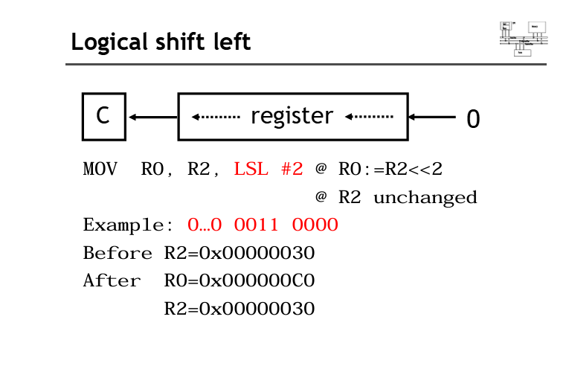

Slide 109
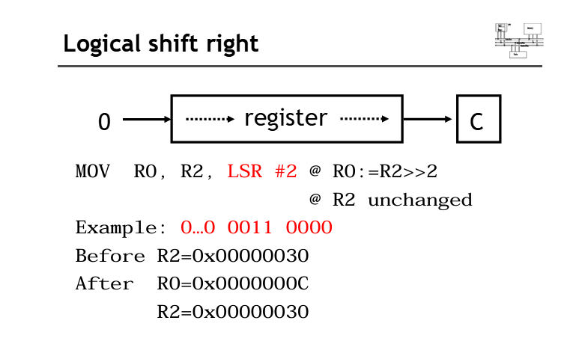

Slide 110
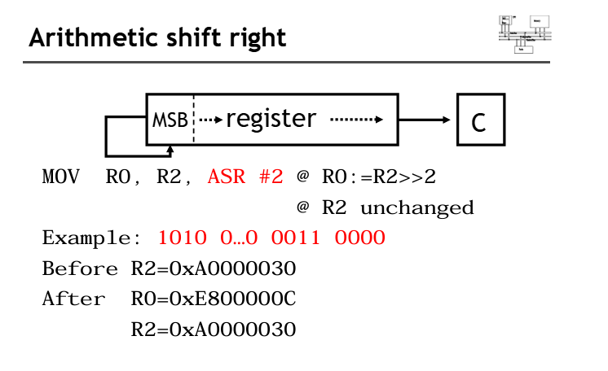

Slide 111
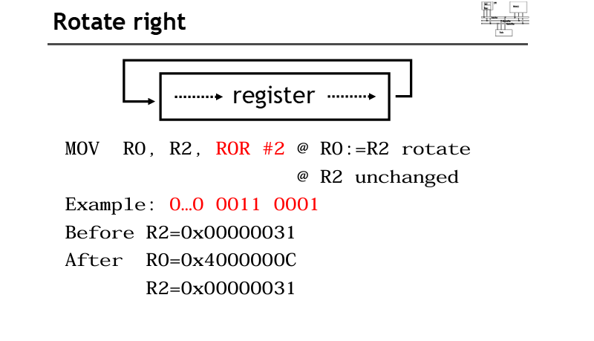

Slide 112
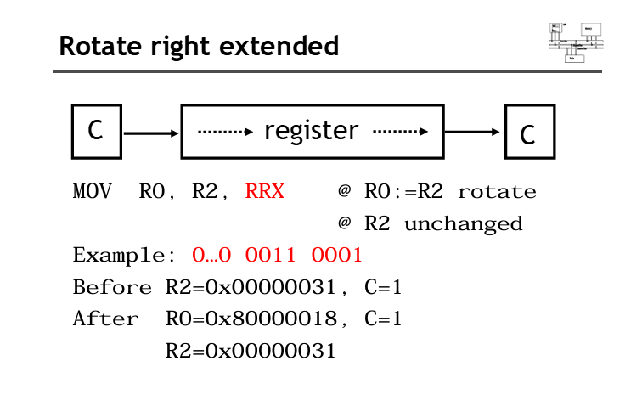

Slide 113


Slide 114


Slide 115


Slide 116

Multiply instructions

Slide 117


Slide 118


Slide 119


Slide 120


Slide 121


Slide 122
Barrel Shifter
The second operand is the one that passes through the barrel shifter. Figure shows the connection of barrel shifter and ALU in ARM processor.
The barrel shifter has the ability to shift 32bits right or le ft by specific number of positions. Register uses the shift operation optionally.
The Shift value can be either5-bit unsigned integer or specified in bottom byte of another register.
The shift operation is also used for multiplication by constant.

Slide 123

We had earlier discussed about immediate value, where the 8-bit number, with a range of 0 – 255 is rotated right through even number of positions.
This preprocessing allows increased range of 32-bit constants that can be loaded directly into registers. Thus barrel shifter brings in a unique and powerful feature for ARM processor.

Slide 124


Slide 125


Slide 126


Slide 127


Slide 128


Slide 129


Slide 130


Slide 131


Slide 132


Slide 133


Slide 134

Addressing Modes in ARM
The phrase addressing modes in ARM relates to the manner an instruction operand is expressed.
Before the operand is actually performed, the addressing mode provides a rule for interpreting or altering the address field of the instruction.

Slide 135


Slide 136


Slide 137


Slide 138
Register indirect addressing mode
A register is utilised in this addressing mechanism to provide the address of the memory region to be accessed. LDR R0, [R1] is an example. This instruction loads the 32-bit word at the memory location contained in register R0 into register R0. This is known as Register indirect addressing mode.

Slide 139


Slide 140


Slide 141


Slide 142


Slide 143


Slide 144


Slide 145


Slide 146


Slide 147


Slide 148


Slide 149


Slide 150


Slide 151


